Slide 1
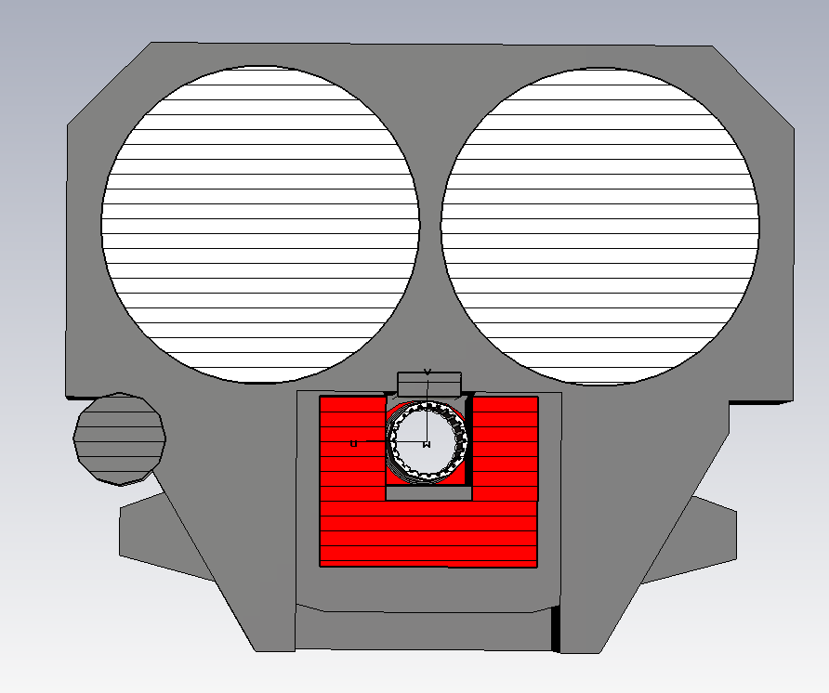
Ceramic capacitor plates
Ground/return busbar
Beam screen
HV busbar
Ferrite yoke
Counter-rotating beam pipe

